Slide 1
2025 VicPD Community Survey Township Of Esquimalt Results

Slide 2
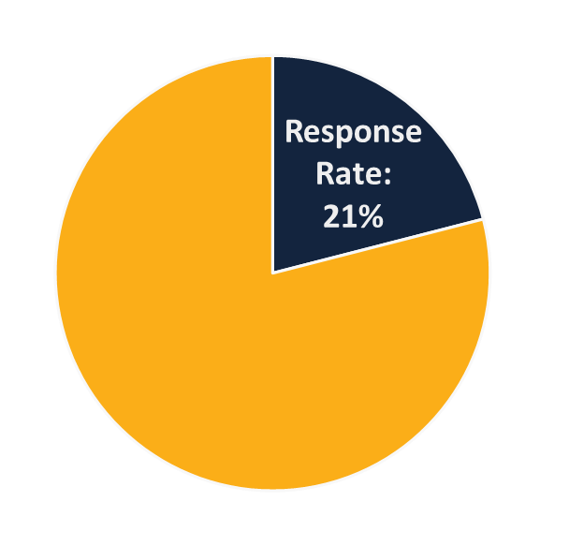

How many responded?
We randomly mailed
1,650
surveys to businesses
& residents of Esquimalt.
349
Margin of Error: 3.01%
(with 95% confidence level)
were completed.
If this survey was administered 100 times, in 95 of those instances the results will reflect the actual population result to within 3.01%.

Slide 3
VicPD Survey Esquimalt Results
This presentation reflects 2021-2025 results for Esquimalt.​
Results specific to Victoria or VicPD’s jurisdiction (combined Esquimalt and Victoria results) are posted on the VicPD website..
For survey questions with changes in responses compared to past years, or of interest, an 11-year trend is displayed for longer-term analysis.
Notes:
Note that these results will be available online after public release.

Slide 4
Satisfaction & Perceptions of VicPD

Slide 5

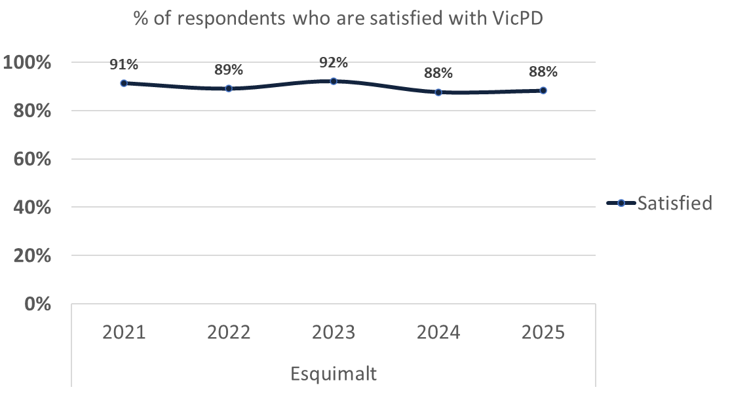
Satisfaction
Notes:
Note: From 2014-2020 "I don't know" was not a recorded option in results (only include people with an opinion). From 2021-2024 the option was added, which gave the appearance of a drop in satisfaction rate. This year, the previous methodology was applied of not including those that do not have an opinion on satisfaction to illustrate a more accurate result.

Slide 6
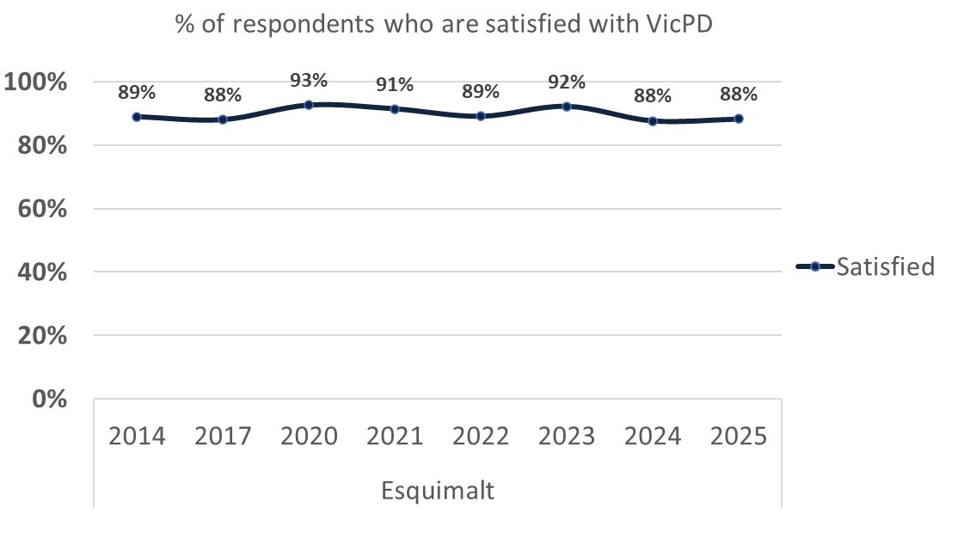
11-year trend: Satisfaction

Slide 7
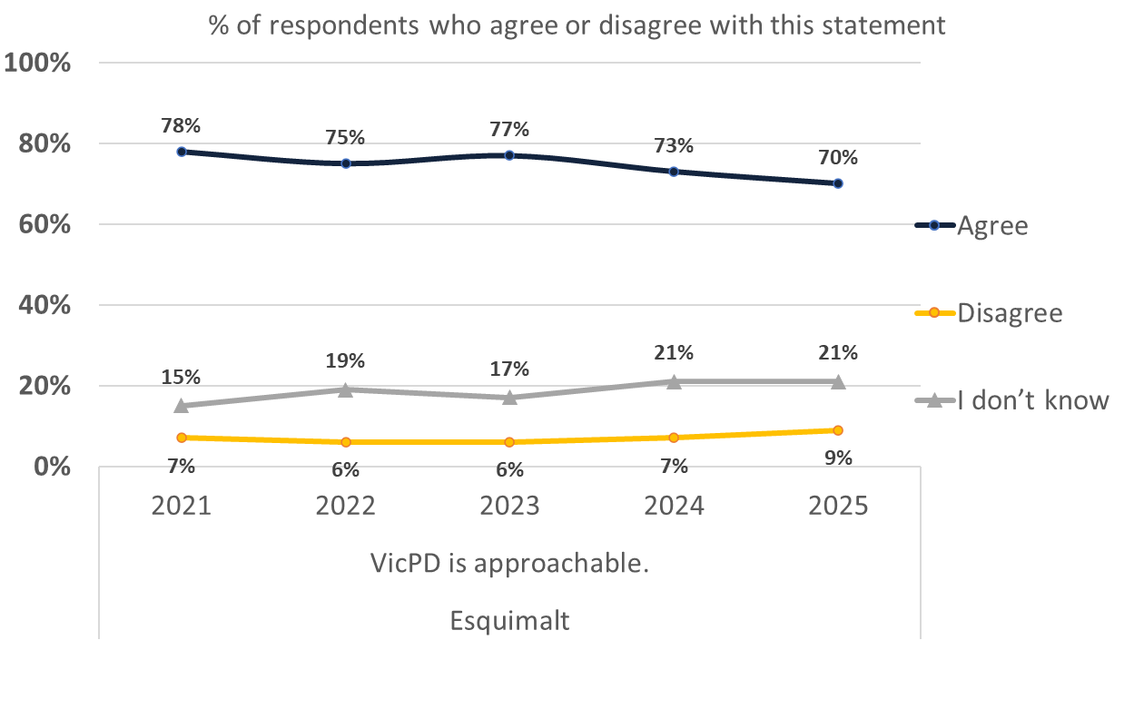
“VicPD is approachable”
Notes:
Note: [wording to follow]

Slide 8
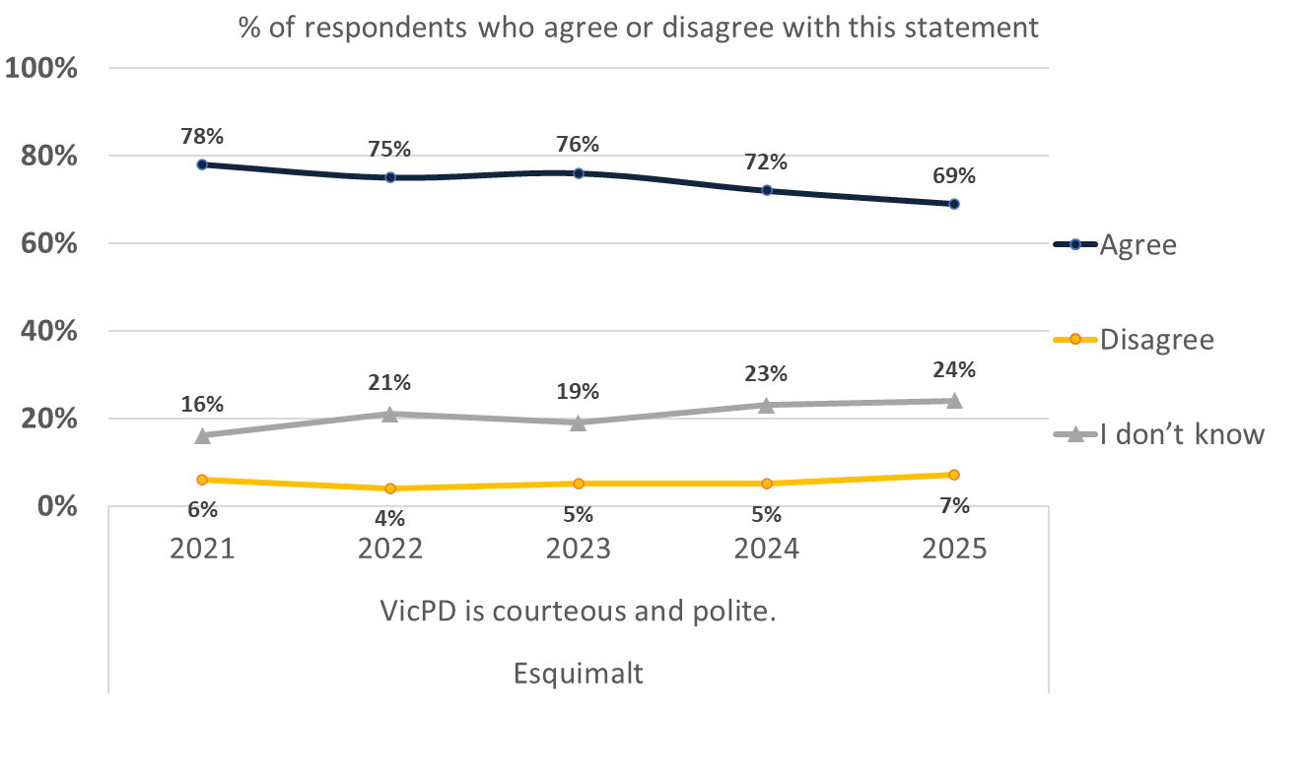
“VicPD is courteous and polite”
Notes:
Note: [wording to follow]

Slide 9
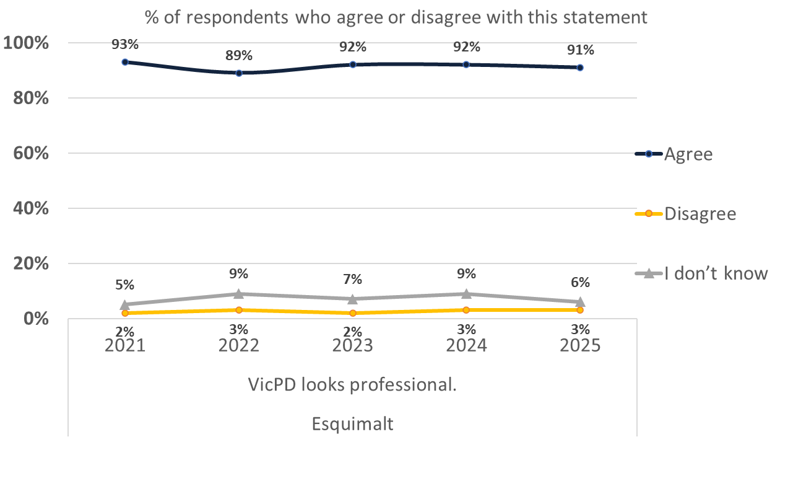
“VicPD looks professional”
Notes:
Note: [wording to follow]

Slide 10
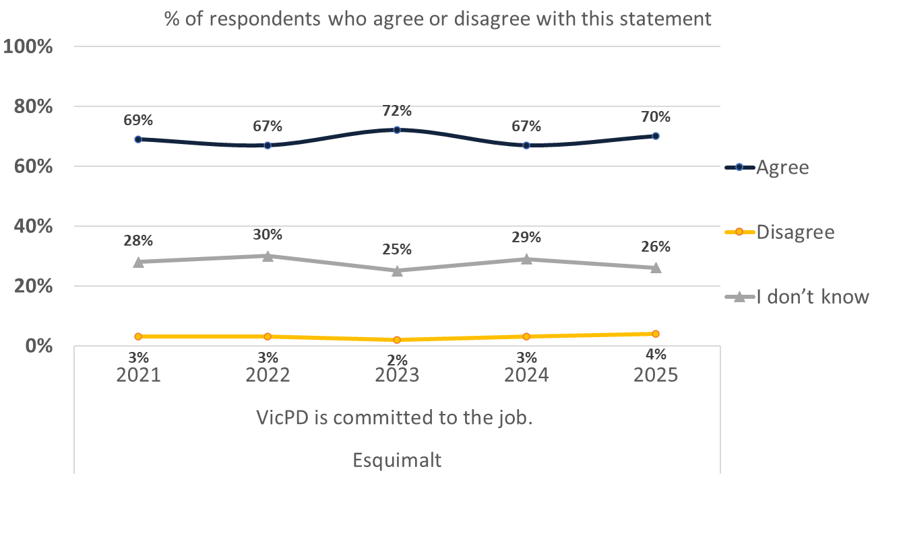
“VicPD is committed to the job”
Notes:
Note: [wording to follow]

Slide 11
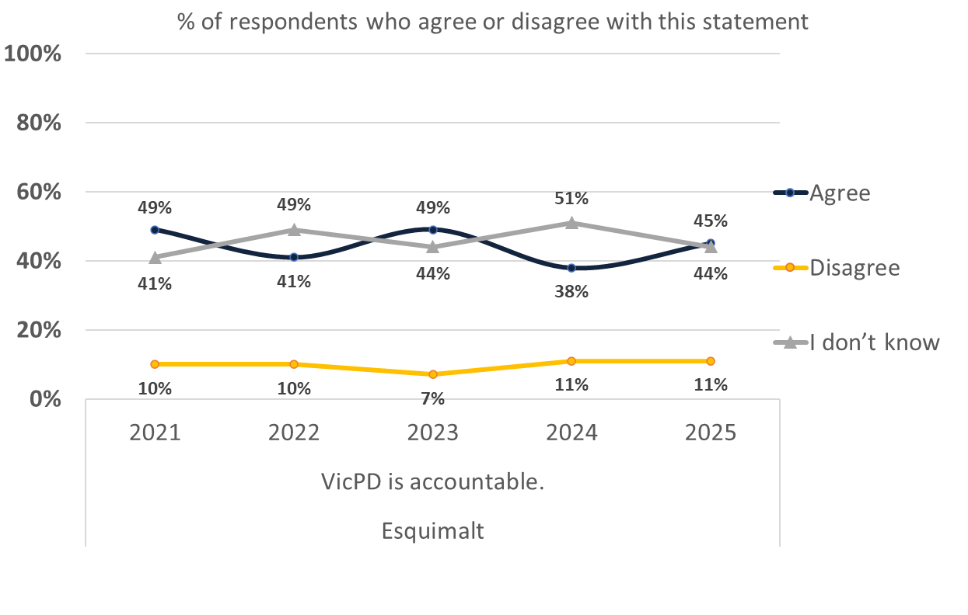
“VicPD is accountable”

Slide 12
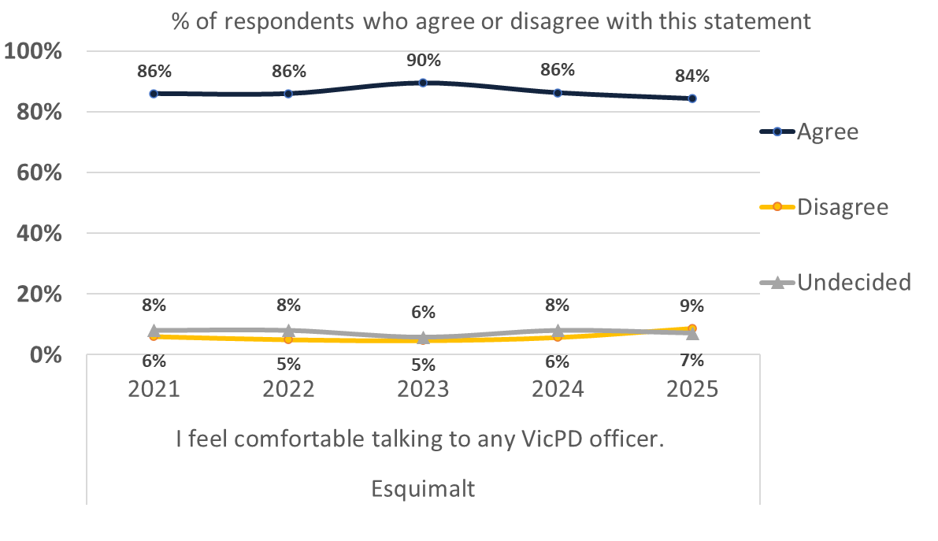
“I feel comfortable talking to VicPD”
Notes:
Note: [wording to follow]

Slide 13
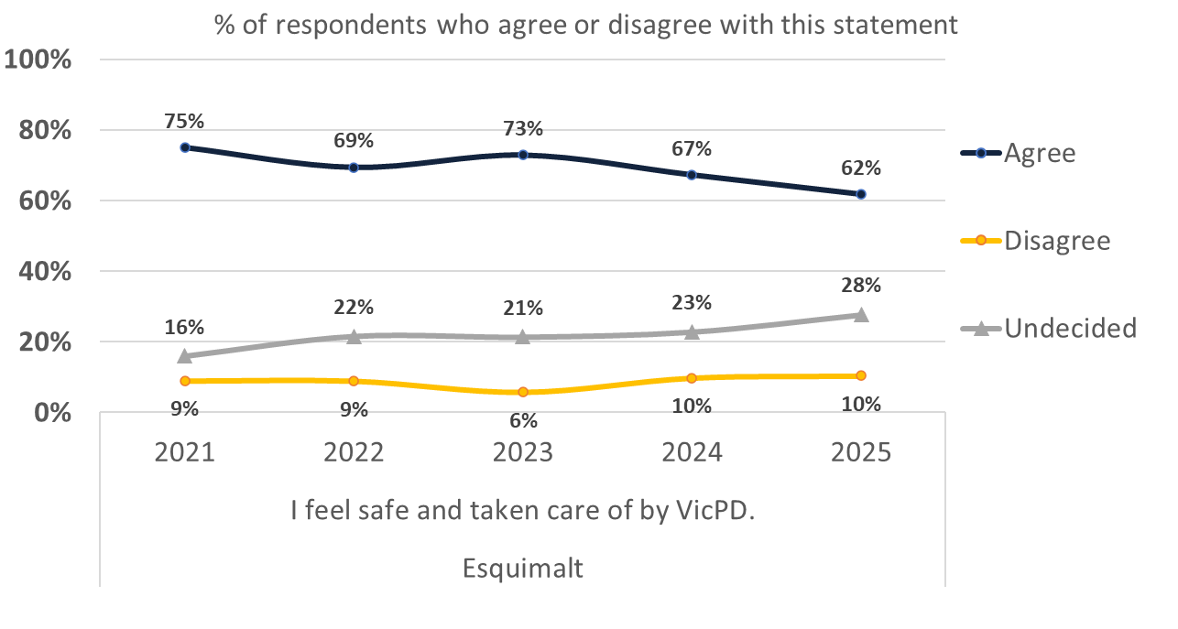
“I feel safe & taken care of by VicPD”
Notes:
Note: [wording to follow]

Slide 14
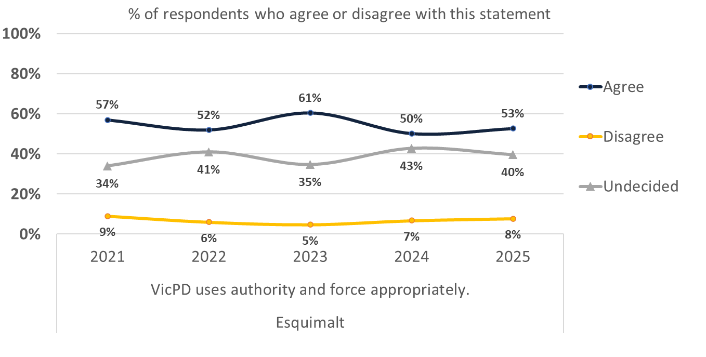
“VicPD uses authority & force appropriately”

Slide 15
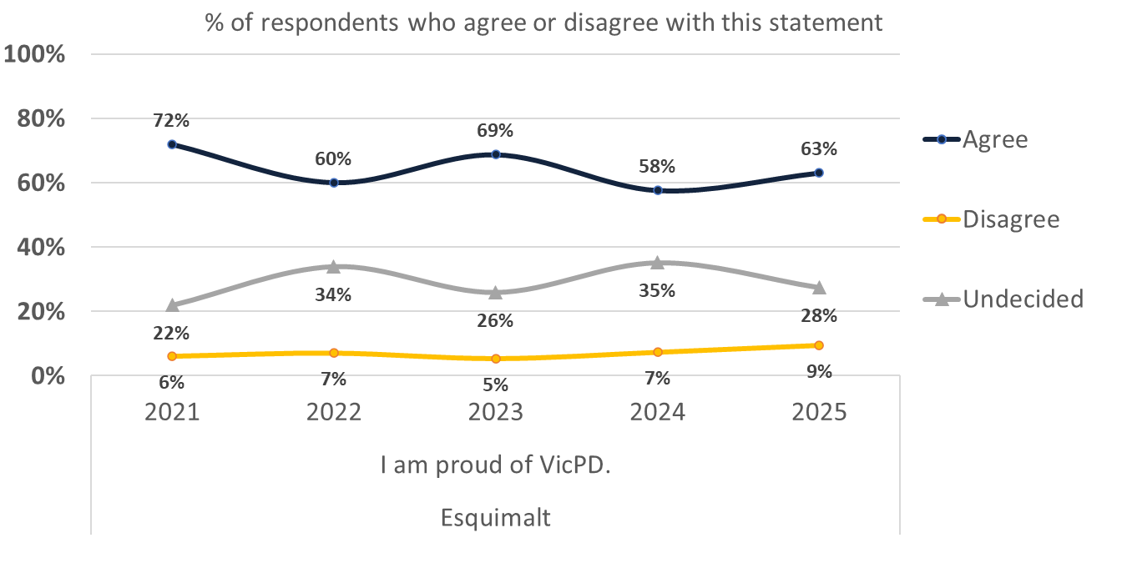
“I am proud of VicPD”

Slide 16
Perceptions of Crime & Feelings of Safety

Slide 17
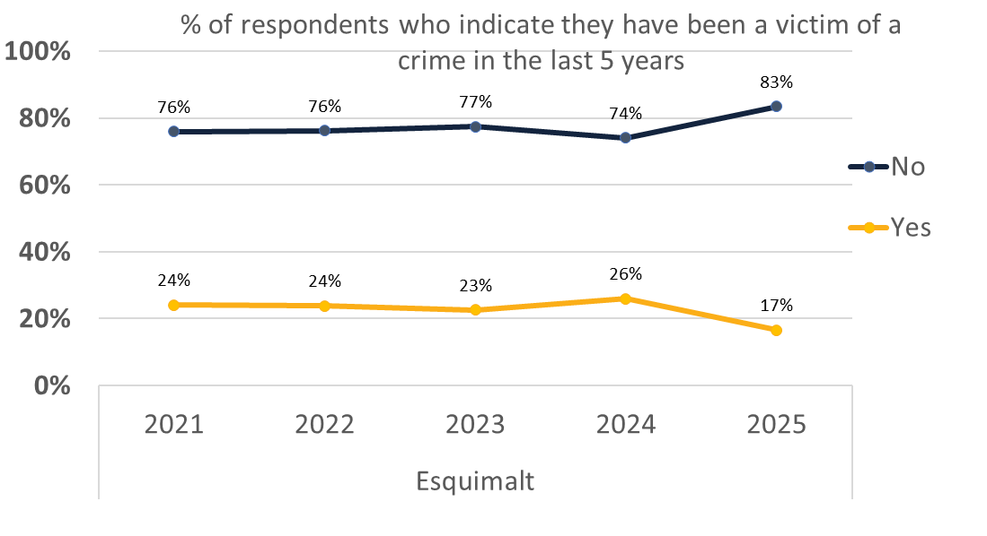
Have you been a victim of crime?
Notes:
Note: this is not a measure of crime within population, crime experienced may not have been reported.

Slide 18
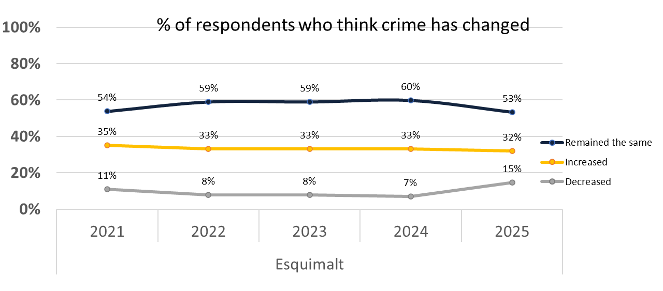
Has crime changed?
Notes:
Note: This is based on perception rather than data. See Stats Canada for actual change. Statistically significant increase 2020-2021; stagnant since.

Slide 19
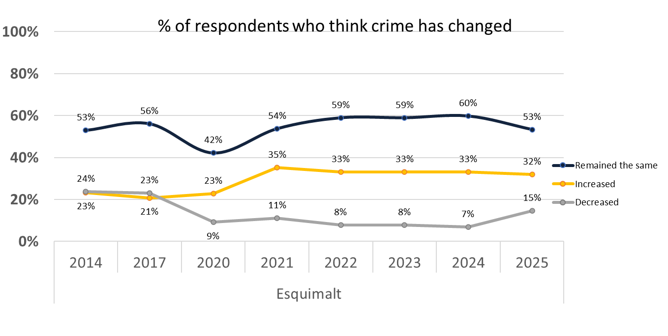
11-year trend: Has crime changed?
Notes:
Note: [wording to follow]

Slide 20
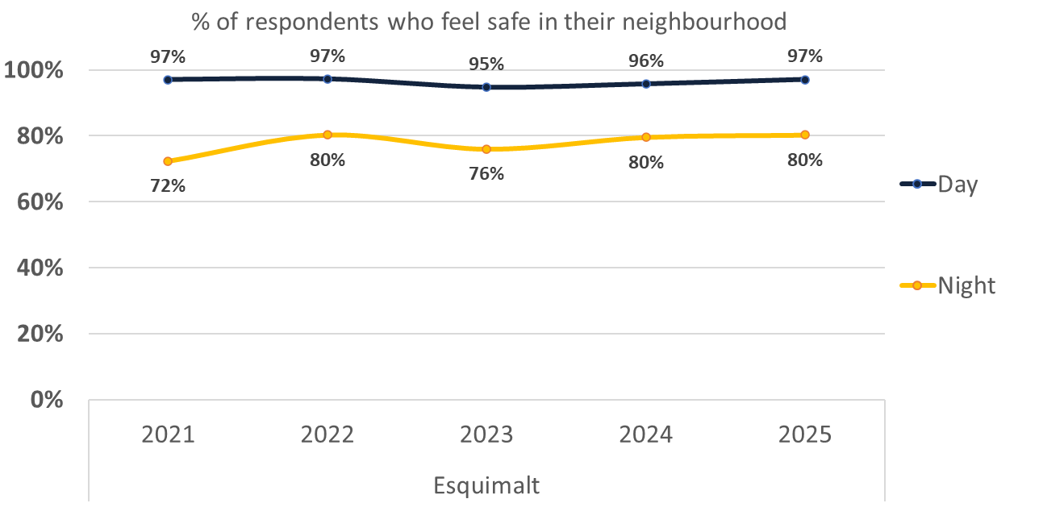
Do you feel safe? Neighbourhood
Notes:
Note: People feel much safer during the day than they do at night.

Slide 21
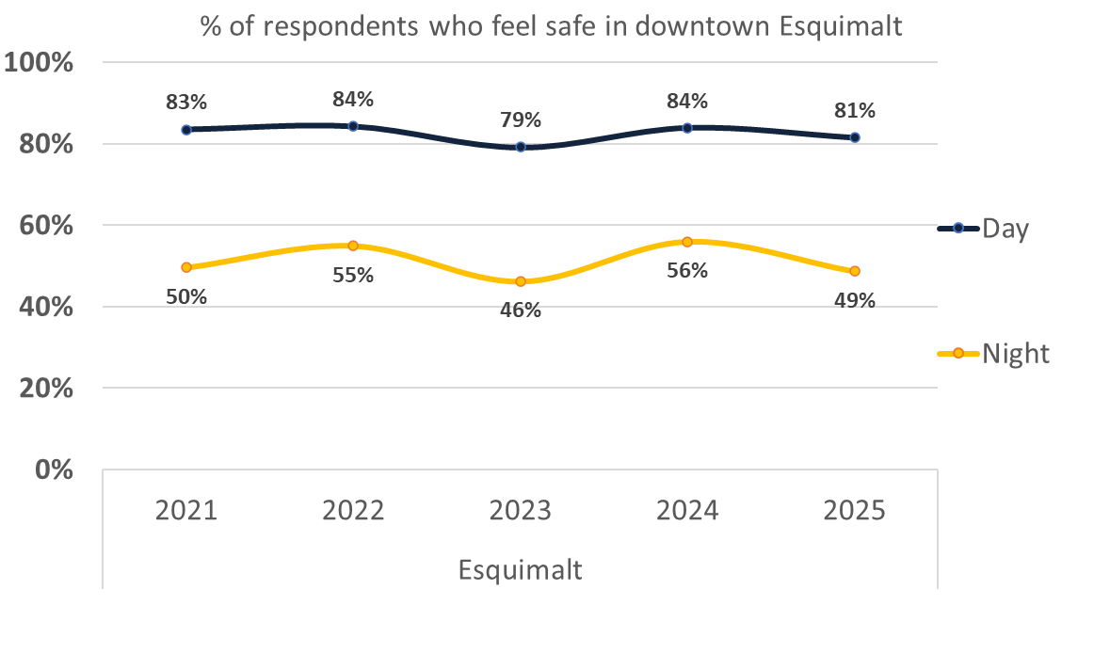
Do you feel safe? Downtown
Notes:
A significant decrease in those that feel safe downtown even in the daytime.

Slide 22
Problems & Solutions

Slide 23
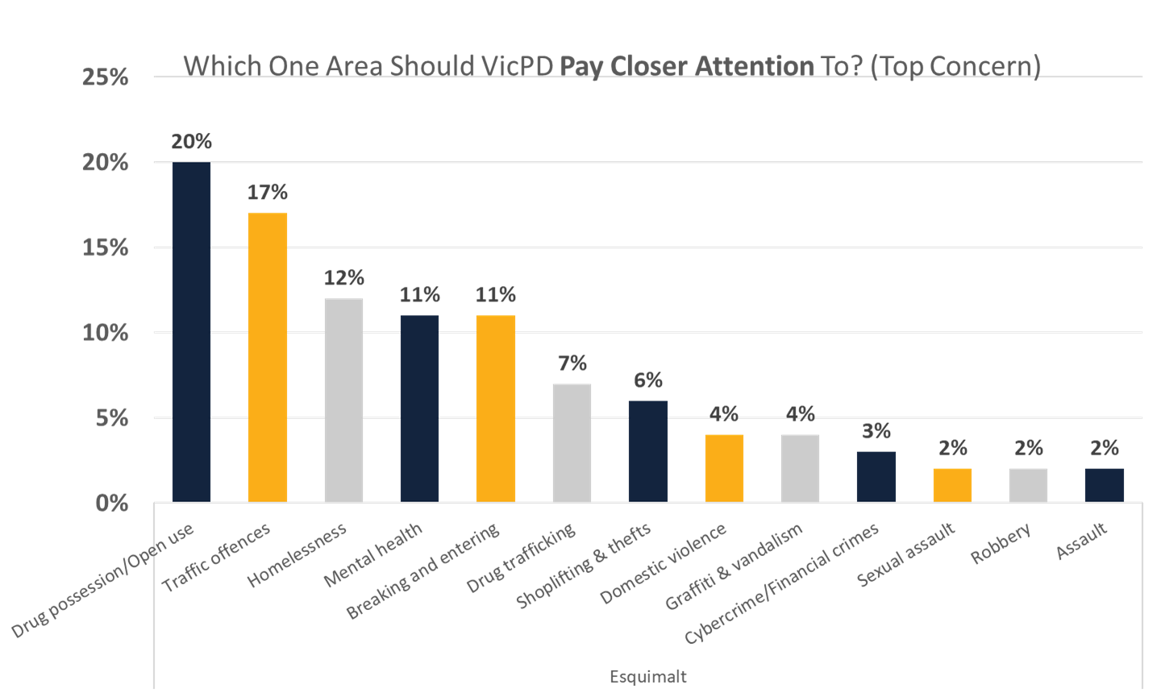
Which one problem should VicPD pay closer attention to?

Slide 24
Top Concern Changes 2024-2025
Notes:
VERY SIMILAR

Slide 25
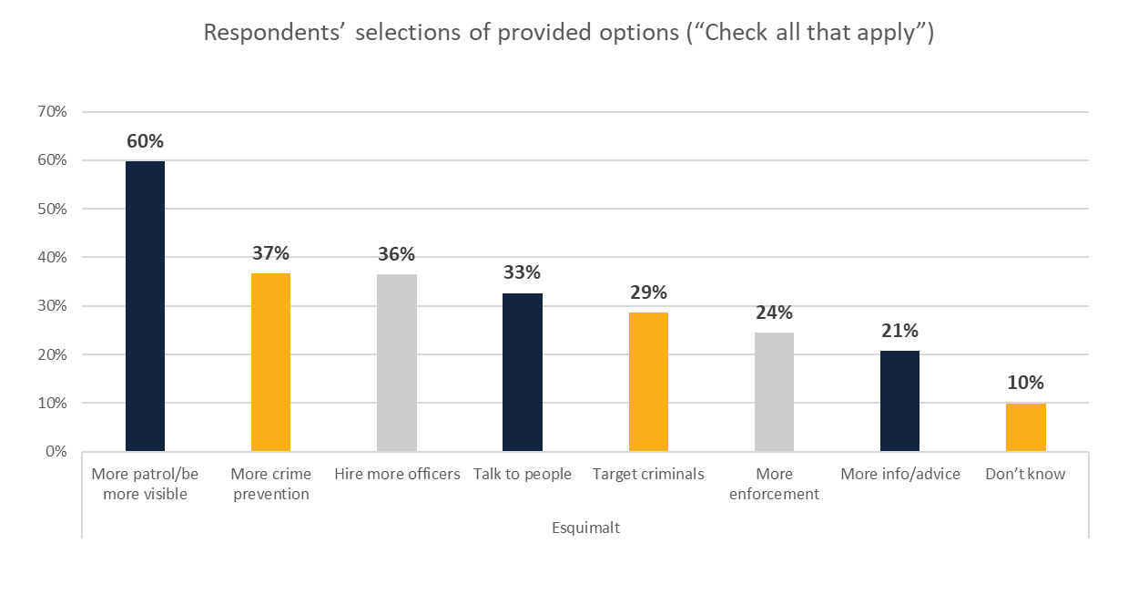
How to deal with problems?

Slide 26
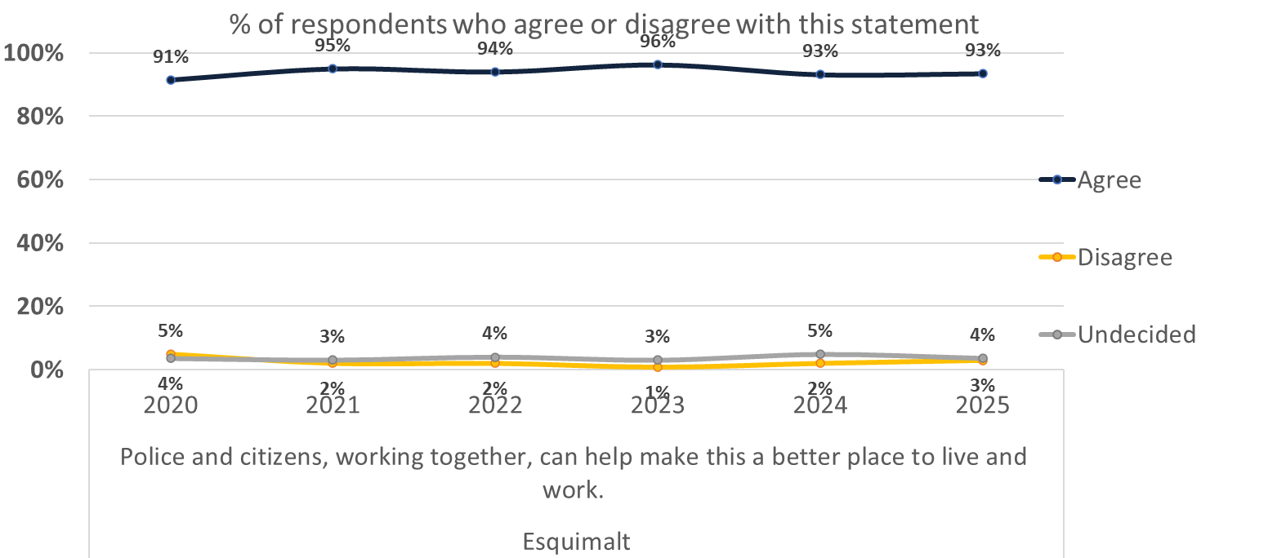
“A Safer Community Together”

Slide 27

For More Survey Results
Visit:
Notes:
Full survey results to be posted on Open VicPD

