Slide 1

2025 VicPD Community Survey: Combined Victoria and Esquimalt Results

Slide 2
Background
Community surveys held in 2014, 2017 and 2020
Annual from 2020 onward
Well received/appreciated by the community
Survey design is based on:
Statistics Canada guidelines on survey design
National environmental scan of existing police surveys
Past surveys, allowing for trend analysis

Slide 3
Methodology
Surveys were mailed to a random sample of addresses to confirm residency/business location in Esquimalt and Victoria
Results are specific to:
VicPD’s jurisdiction (Esquimalt and Victoria)
One option for completion:
Online (with unique code). Respondents who have access challenges were able to complete the survey by telephone.

Slide 4
Our survey: one of the many ways we connect with our community
VicPD’s community engagement
Focus groups
Social media discussions
Face-to-face interaction
Community events
Outreach to Indigenous groups
Diversity Advisory Committee
VicPD Civic Service Awards
Community Survey
Outreach by Community Resource Officers
Open VicPD
Media

Slide 5
Timeline
February/March: prepared surveys
April: Distributed surveys
April-May: Survey closed; analyzed results
June-July: Internal and public engagement to share findings

Slide 6

How many responded?
We randomly mailed
5,000
surveys to
Victoria and Esquimalt.
1,050
Margin of Error: 3.01%
(with 95% confidence level)
were completed.
If this survey was administered 100 times, in 95 of those instances the results will reflect the actual population result to within 3.01%.

Slide 7
Combined VicPD Survey Results
This presentation reflects annual results from 2021-2025 for VicPD’s jurisdiction (combined results for residents and businesses in Esquimalt and Victoria).
Results specific to Esquimalt and Victoria are also available.
For survey questions with significant changes in responses compared to past years, an 11-year trend is displayed for longer-term analysis
Notes:
Note that these results will be available online after public release.

Slide 8
Satisfaction & Perceptions of VicPD

Slide 9

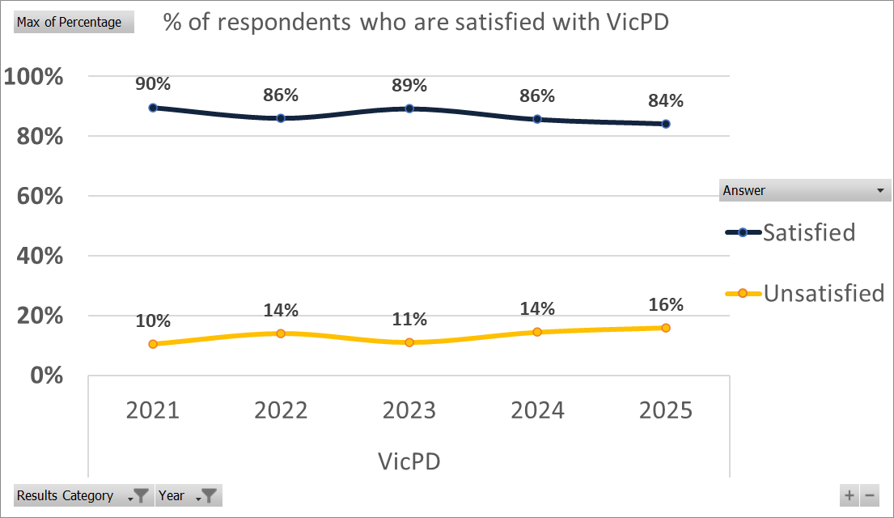
Satisfaction
Notes:
Note: From 2014-2020 "I don't know" was not a recorded option in results (only include people with an opinion). From 2021-2024 the option was added, which gave the appearance of a drop in satisfaction rate. This year, the previous methodology was applied of not including those that do not have an opinion on satisfaction to illustrate a more accurate result.

Slide 10
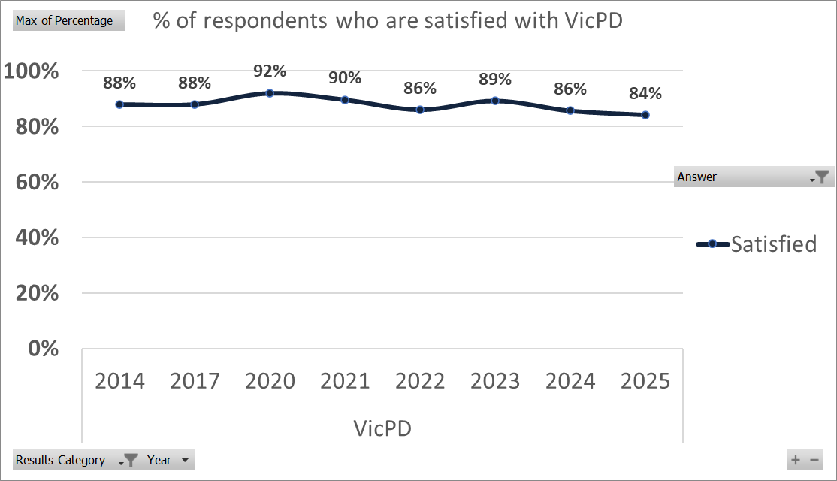
11-year trend: Satisfaction

Slide 11
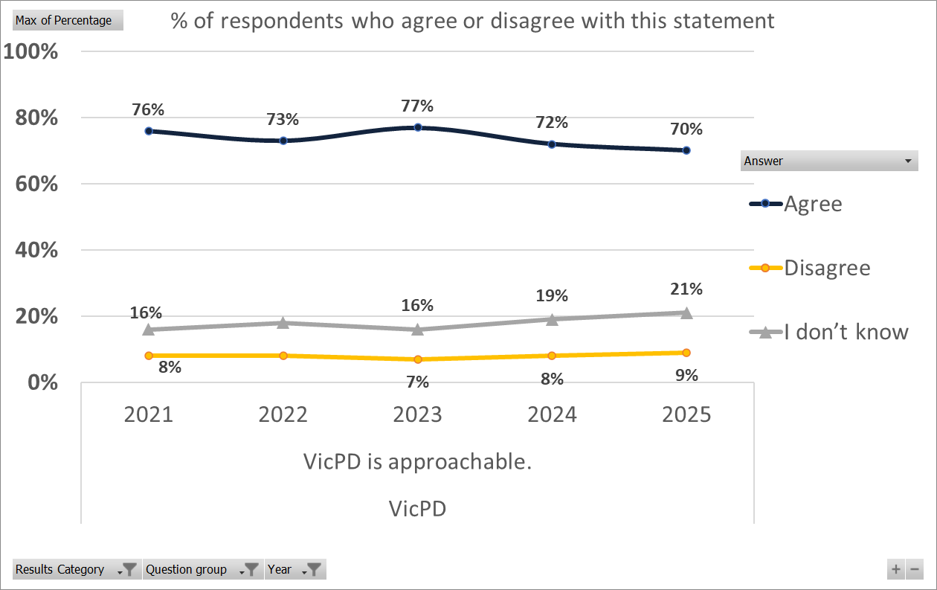
“VicPD is approachable”
18%
8%
Notes:
Note: [wording to follow]

Slide 12
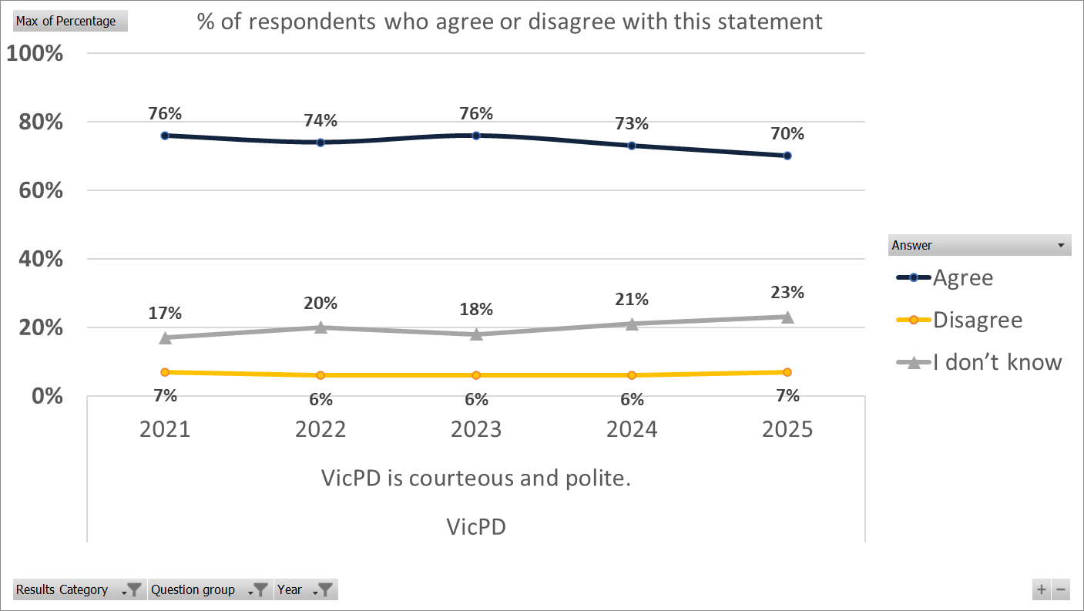
“VicPD is courteous and polite”
Notes:
Note: [wording to follow]

Slide 13
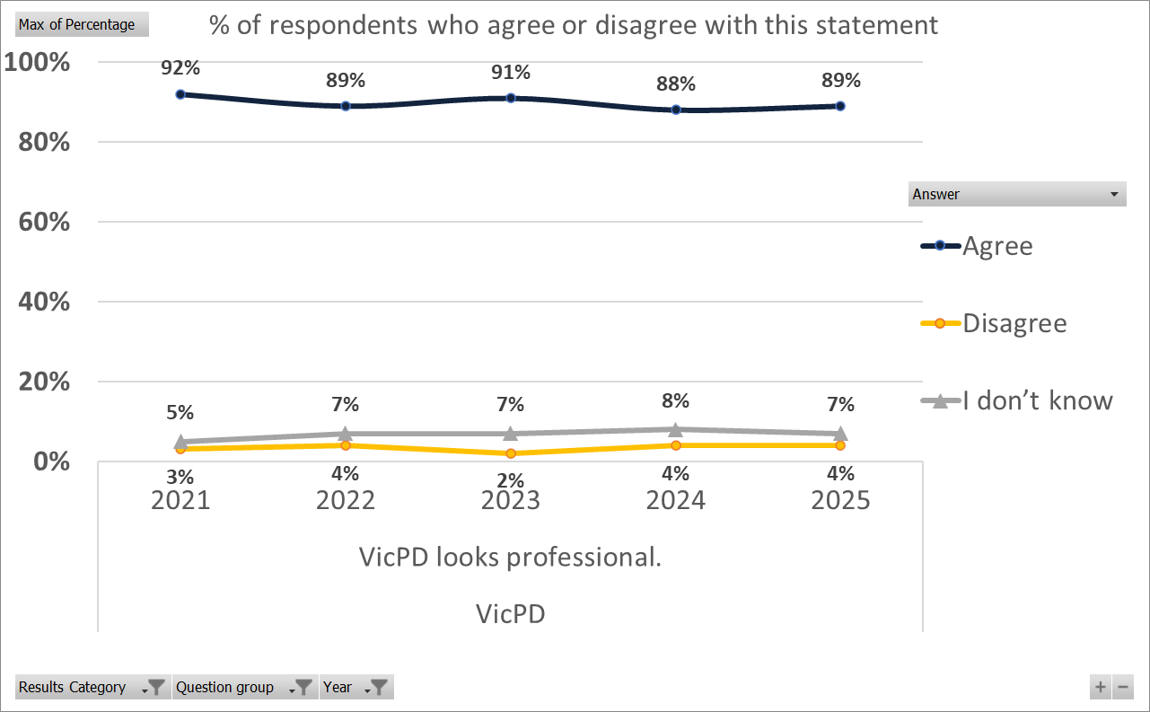
“VicPD looks professional”
Notes:
Note: [wording to follow]

Slide 14
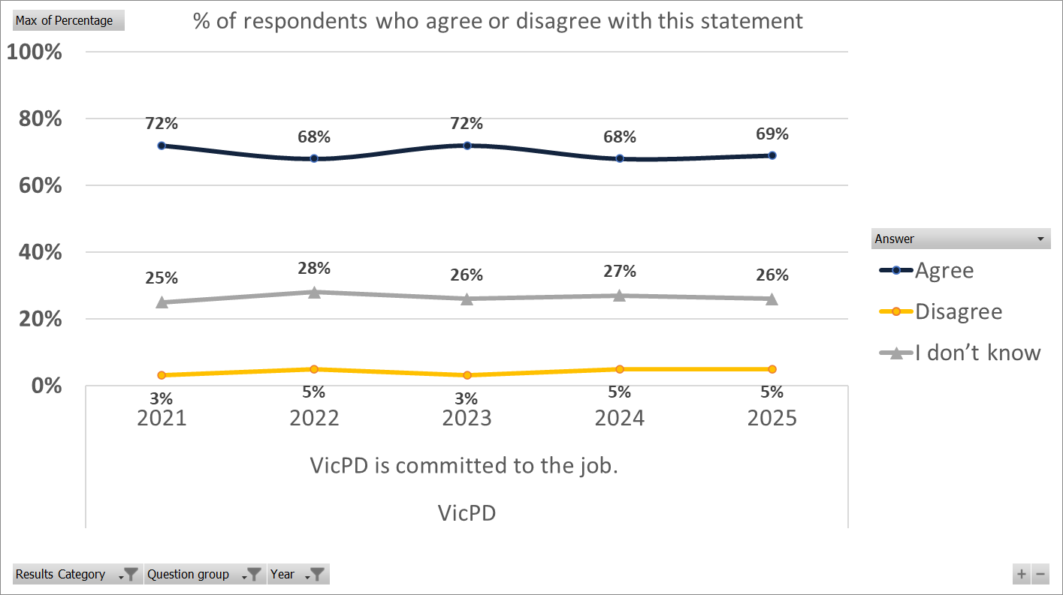
“VicPD is committed to the job”
Notes:
Note: [wording to follow]

Slide 15
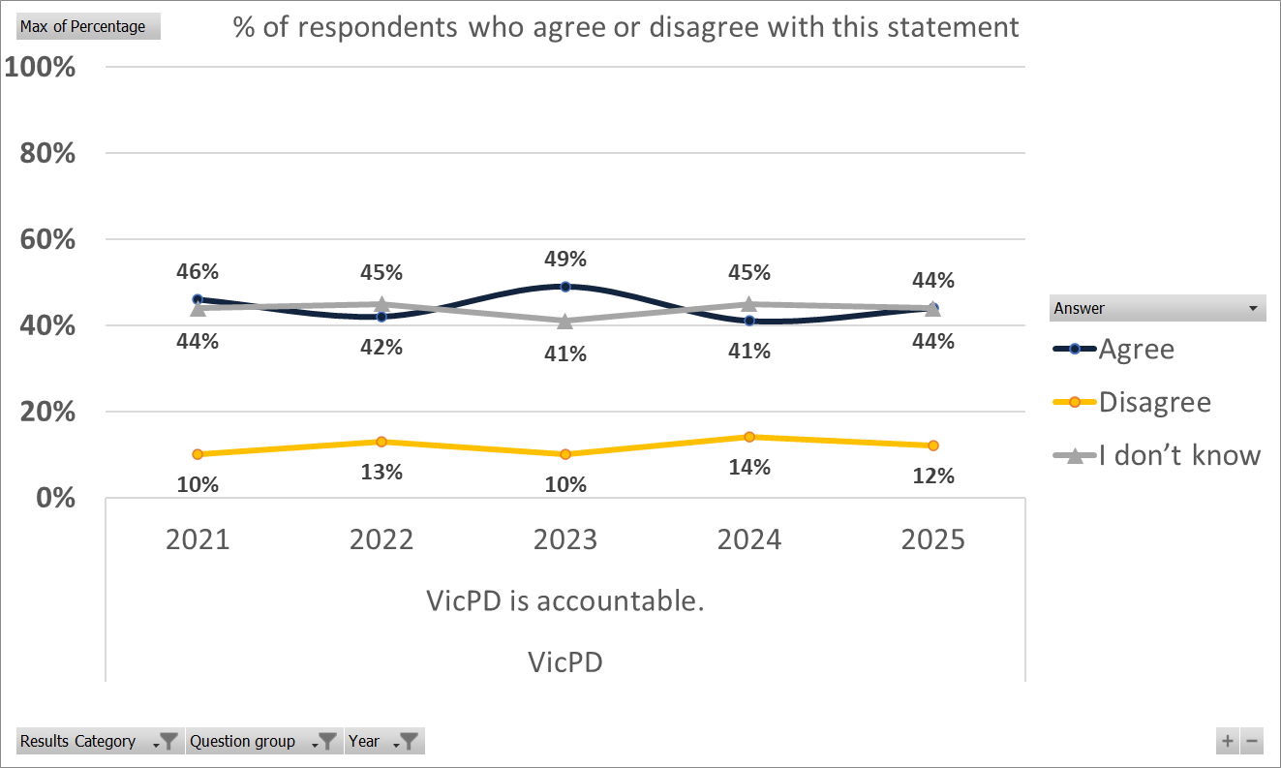
“VicPD is accountable”

Slide 16
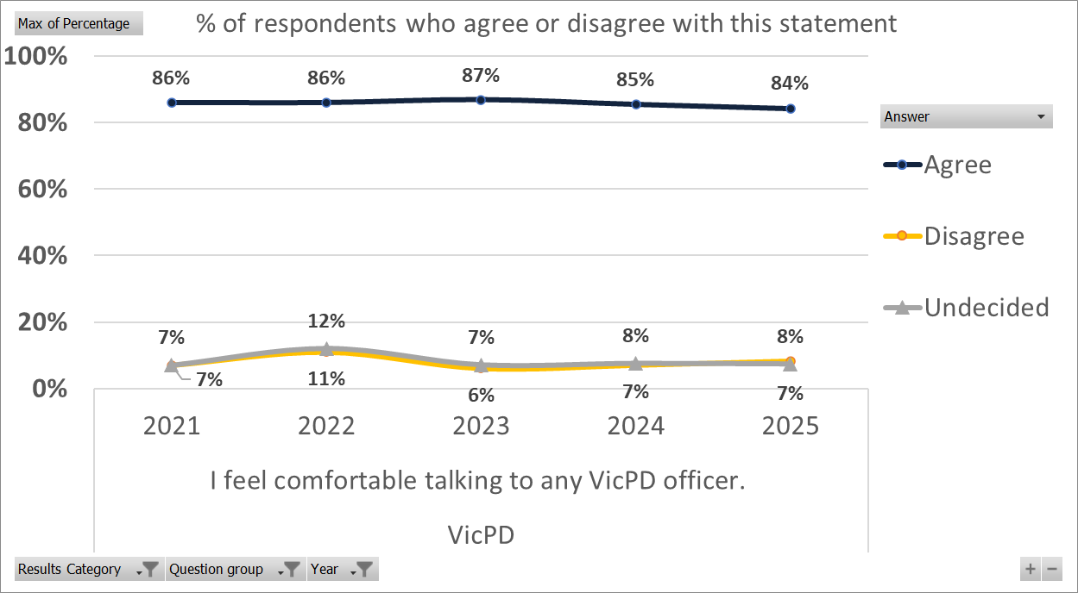
“I feel comfortable talking to VicPD”
Notes:
Note: [wording to follow]

Slide 17
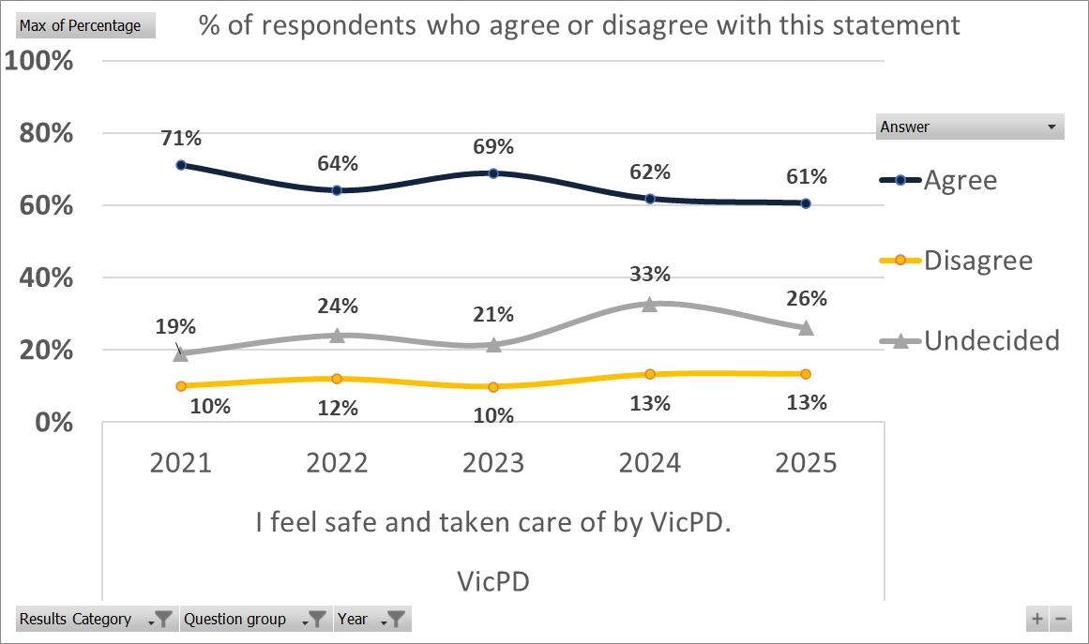
“I feel safe & taken care of by VicPD”
Notes:
Note: [wording to follow]

Slide 18
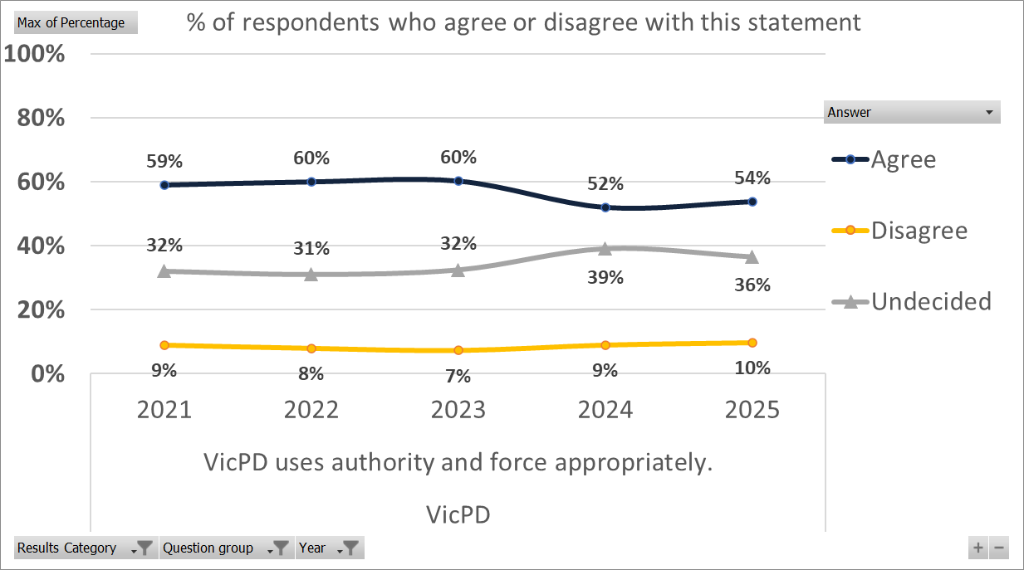
“VicPD uses authority & force appropriately”

Slide 19
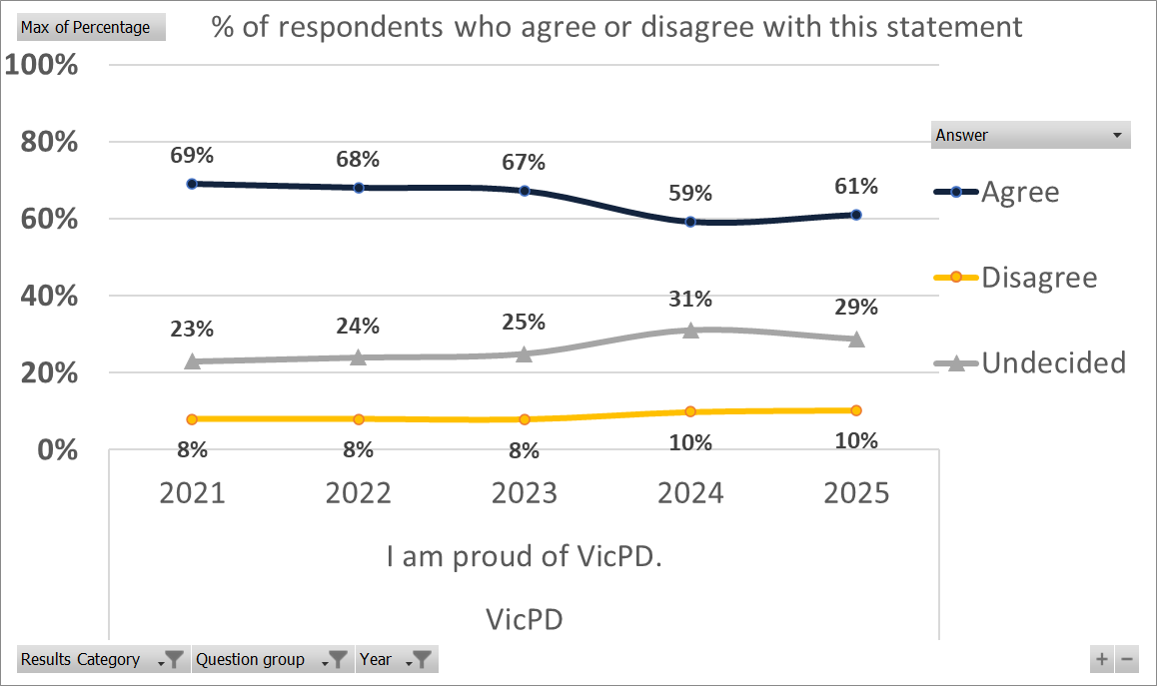
“I am proud of VicPD”

Slide 20
Perceptions of Crime & Feelings of Safety

Slide 21
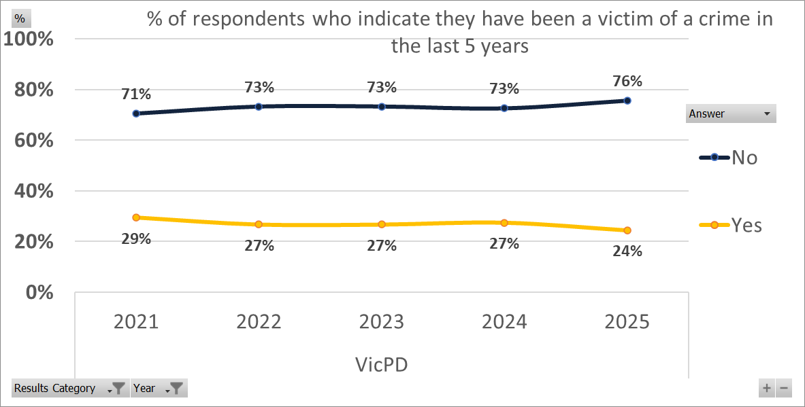
Have you been a victim of crime?
Notes:
Note: this is not a measure of crime within population, crime experienced may not have been reported.

Slide 22
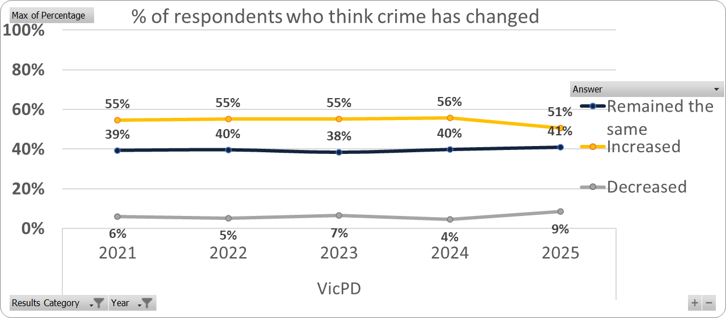
Has crime changed?
Notes:
Note: This is based on perception rather than data. See Stats Canada for actual change. Statistically significant increase 2020-2021; stagnant since.

Slide 23
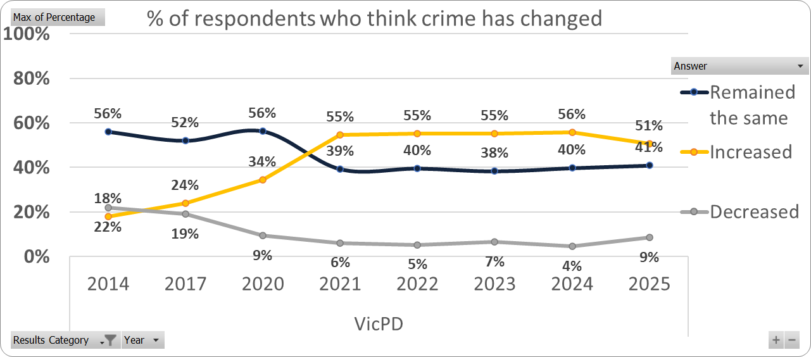
11-year trend: Has crime changed?
Notes:
Note: [wording to follow]

Slide 24
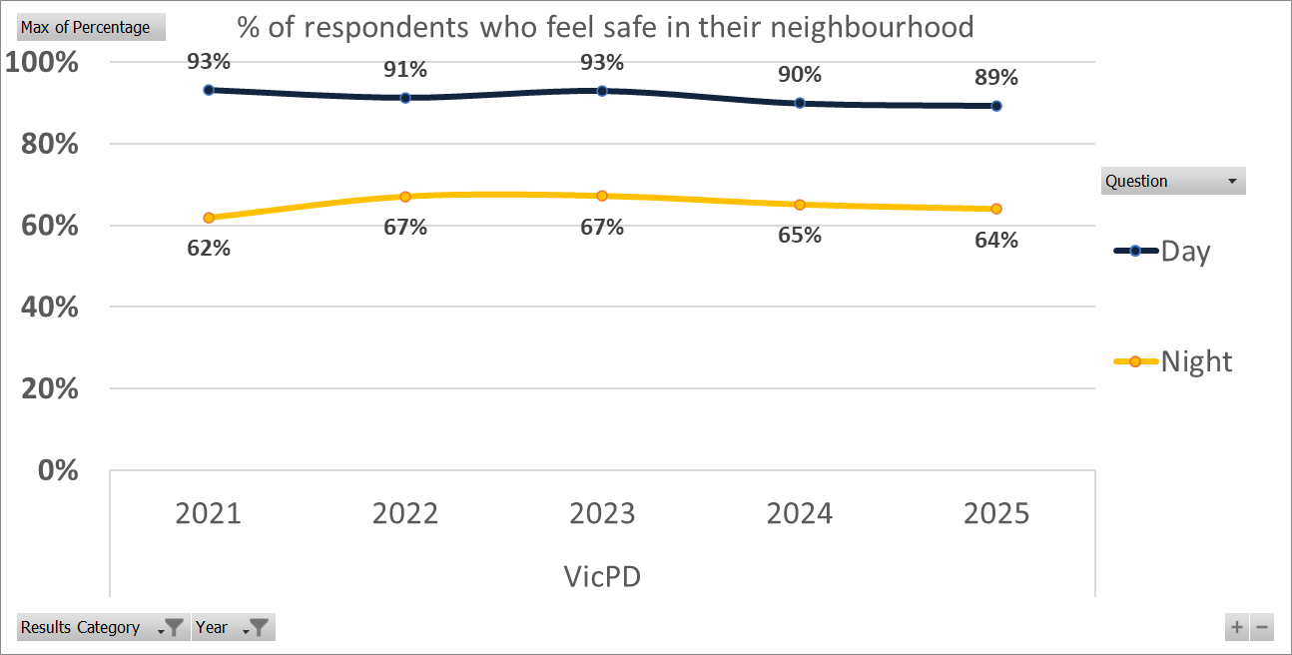
Do you feel safe? Neighbourhood
Notes:
Note: People feel much safer during the day than they do at night.

Slide 25
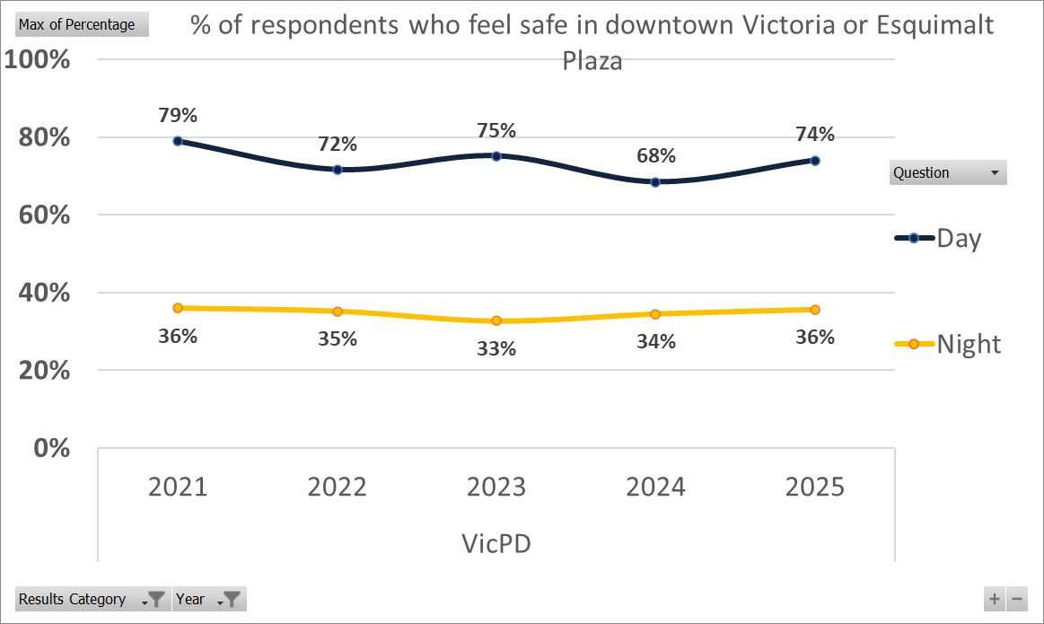
Do you feel safe? Downtown
Notes:
A significant decrease in those that feel safe downtown even in the daytime.

Slide 26
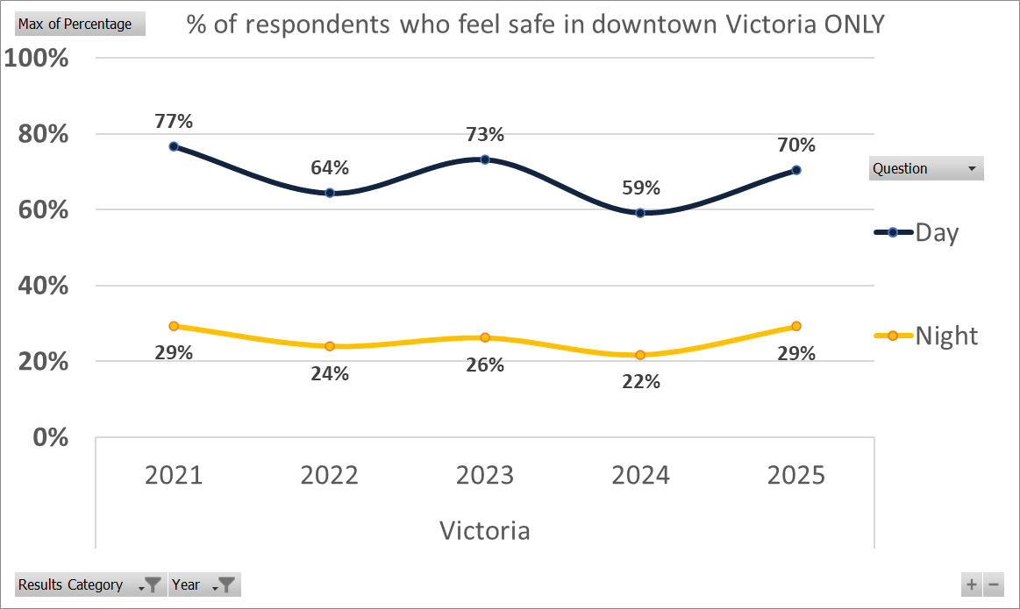
Do you feel safe? Downtown (Vic)
Notes:
A significant increase in those that feel safe downtown, even in the night.

Slide 27
Problems & Solutions

Slide 28
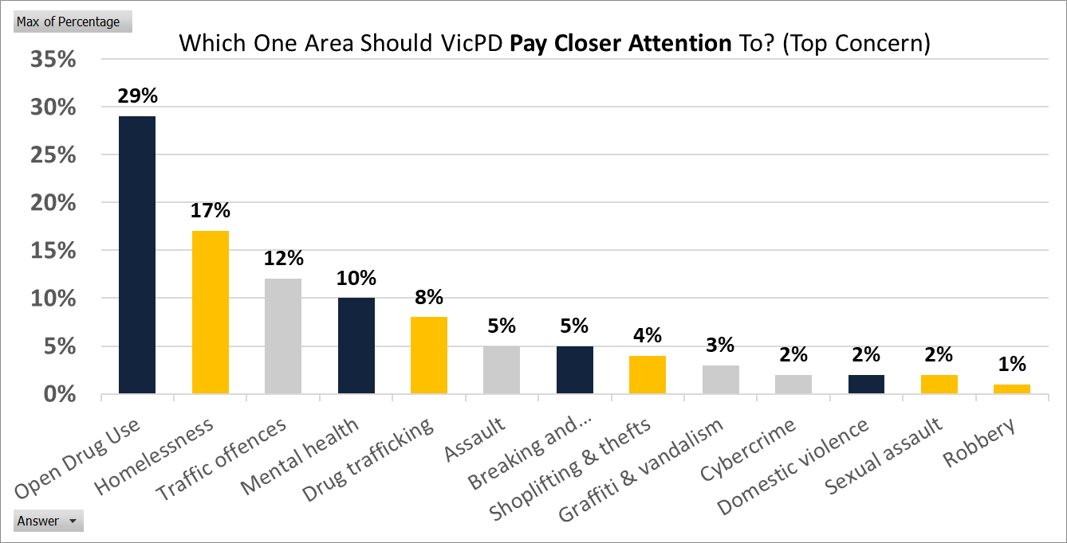
Which one problem should VicPD pay closer attention to?
Notes:
First time including new cybercrime/financial crime category.
Significant increase to Drug possession/open use becoming highest concern (next slide has last year’s as a comparison

Slide 29
Top Concern Changes 2024 - 2025
2024
2025
Open Drug Use (26%)
Homelessness (17%)
Traffic Offences (14%)
Mental Health (10%)
Break & Enters (7%)
Drug Trafficking (7%)
Physical Assault (6%)
Shoplifting & Theft (4%)
Robbery (2%)
Cybercrime (2%)
Graffiti & Vandalism (2%)
Domestic Violence (2%)
Sexual Assault (1%)
Open Drug Use (29%)
Homelessness (17%)
Traffic Offences (12%)
Mental Health (10%)
Drug Trafficking (8%)
Physical Assault (5%)
Break and Enters (5%)
Shoplifting & Theft (4%)
Graffiti & Vandalism (3%)
Cybercrime (2%)
Domestic Violence (2%)
Sexual Assault (2%)
Robbery (1%)
Notes:
Note:

Slide 30
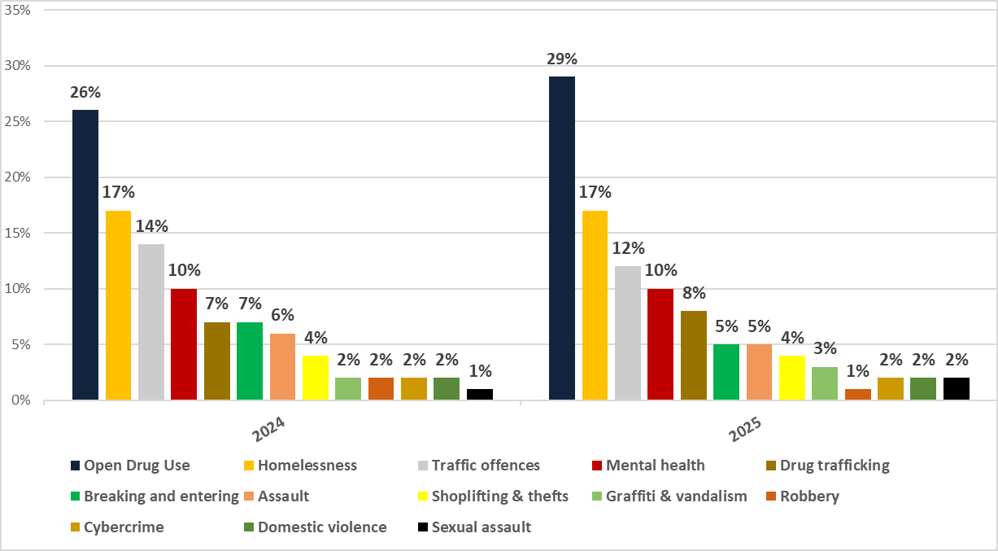
Top Concern Changes 2024 - 2025

Slide 31
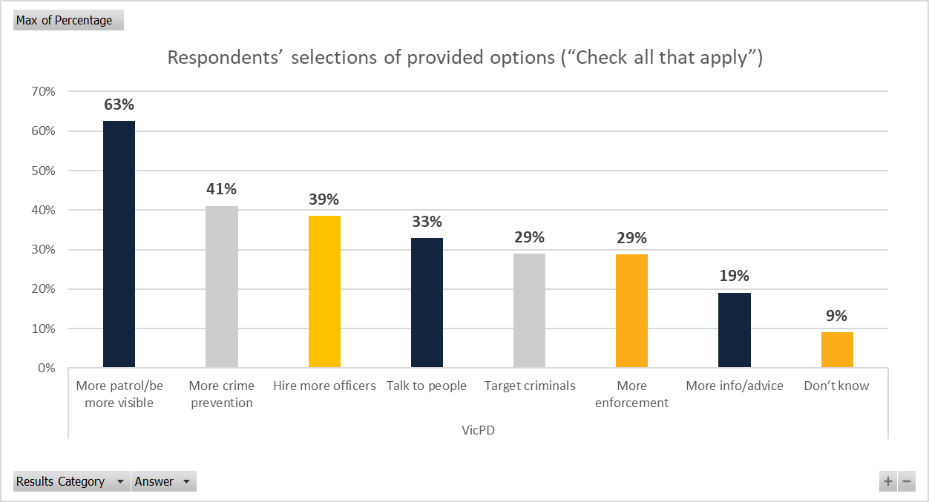
How to deal with problems?

Slide 32
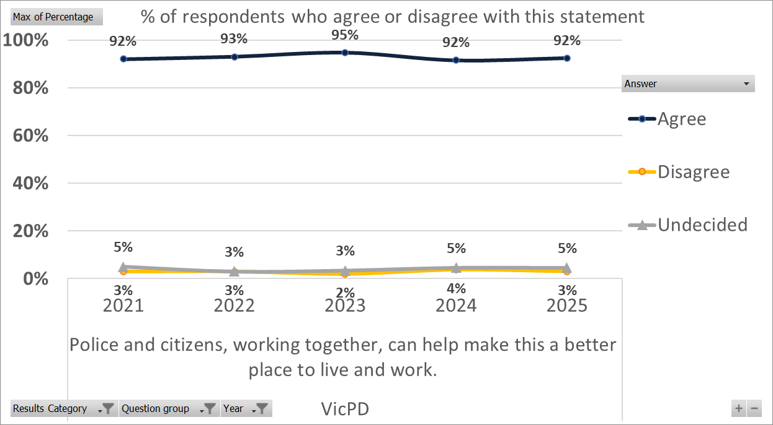
“A Safer Community Together”

Slide 33
Comments Summary
Respondents were invited to write in comments
Of 1050 respondents, 587 offered comments of substance (56%)
Common themes included: appreciation, the value of community policing, concerns about social disorder and property crime, and a desire for more visibility.

Slide 34
Sample Comments (1/4)
“"The increased foot patrols downtown have made a noticeable difference. It feels safer and more welcoming."”
“Our community liaison officer is fantastic. They are always available to answer questions and address concerns.”
“I appreciate the police department’s efforts to educate the public about scams and fraud.”

Slide 35
Sample Comments (2/4)
“More bike patrols in parks and along the waterfront would be great. It’s a good way to cover a lot of ground and engage with the community.”
"I've had positive interactions with officers responding to noise complaints in my neighborhood. They were professional and respectful."
“The police department’s presence at local events is always appreciated. It creates a positive atmosphere and builds trust.”

Slide 36
Sample Comments (3/4)
“We’ve seen a significant increase in property crime in our neighborhood. It’s unsettling and makes us feel unsafe.”
“The growing number of street encampments is creating a lot of problems for residents and businesses. Something needs to be done to address this issue.”
“I reported a suspicious activity but never received any follow-up. It made me feel like my concerns weren't taken seriously.”

Slide 37
Sample Comments (4/4)
"The increase in drug use and homelessness is creating a dangerous environment. Something needs to be done."
“The downtown core feels increasingly unsafe, especially at night. There are a lot of aggressive panhandlers and people struggling with addiction.”

Slide 38

For More Survey Results
Visit:
Notes:
Full survey results to be posted on Open VicPD

